Slide 1
JavaScript for Web Warriors, 7e Chapter 2: Working with Functions, Data Types, and Operators

Slide 2
Chapter Objectives (1 of 2)
By the end of this chapter, you should be able to:
Write and call functions to perform actions and calculate values.
Associate functions with events using event handlers and event listeners.
Use built-in JavaScript functions.
Understand the scope of variables and functions.
Understand the data types supported by JavaScript and write expressions with numeric values, text strings, and Boolean values.
Notes:
Instructions: Briefly review with students the major concepts you will be covering during this class. There is one objective for every major A-head section of the chapter.

Slide 3
Chapter Objectives (2 of 2)
By the end of this chapter, you should be able to:
Create expressions using arithmetic, assignment, comparison, logical, string, and special operators.
Understand order precedence and associativity of operations.
Work with events and values associated with form controls.
Access your browser’s debugging console.
Notes:
Instructions: Briefly review with students the major concepts you will be covering during this class. There is one objective for every major A-head section of the chapter.

Slide 4
Working with Functions (1 of 4)
Function: a programming structure consisting of a collection of statements that share a common purpose or calculate a value
Defining a function
Syntax for a named function: function functionName(parameters) { statements }
Syntax for an anonymous function: function (parameters) { statements }
Function’s parameters are the variables it uses
Enclosed in a command block (opening and closing curly braces)

Slide 5
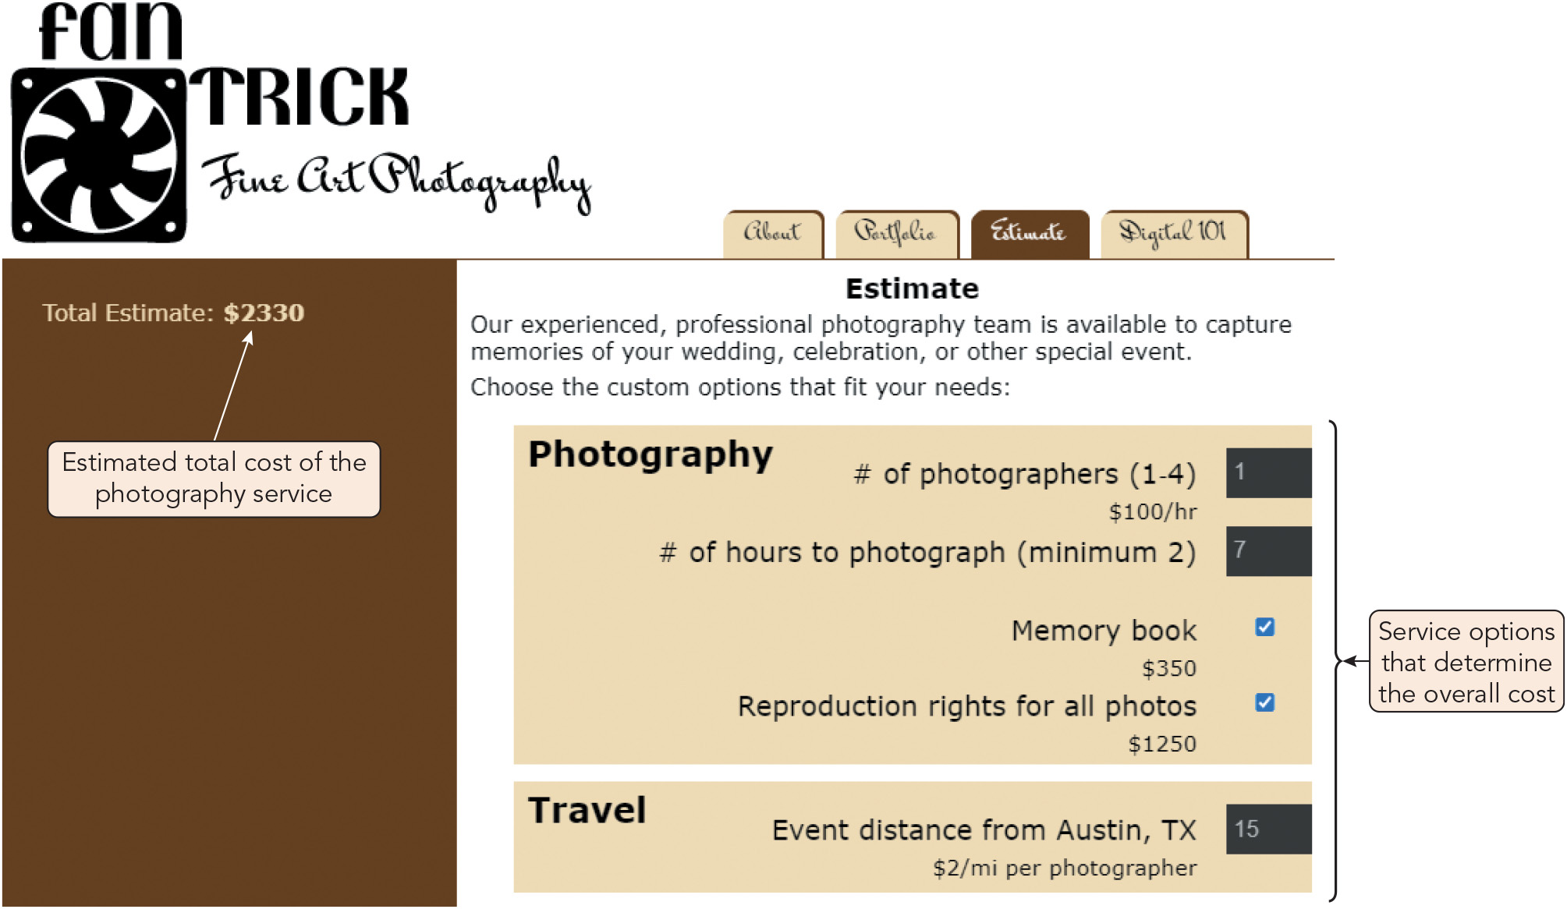
Working with Functions (2 of 4)
Figure 2-1 Estimating the total photography charge

Slide 6
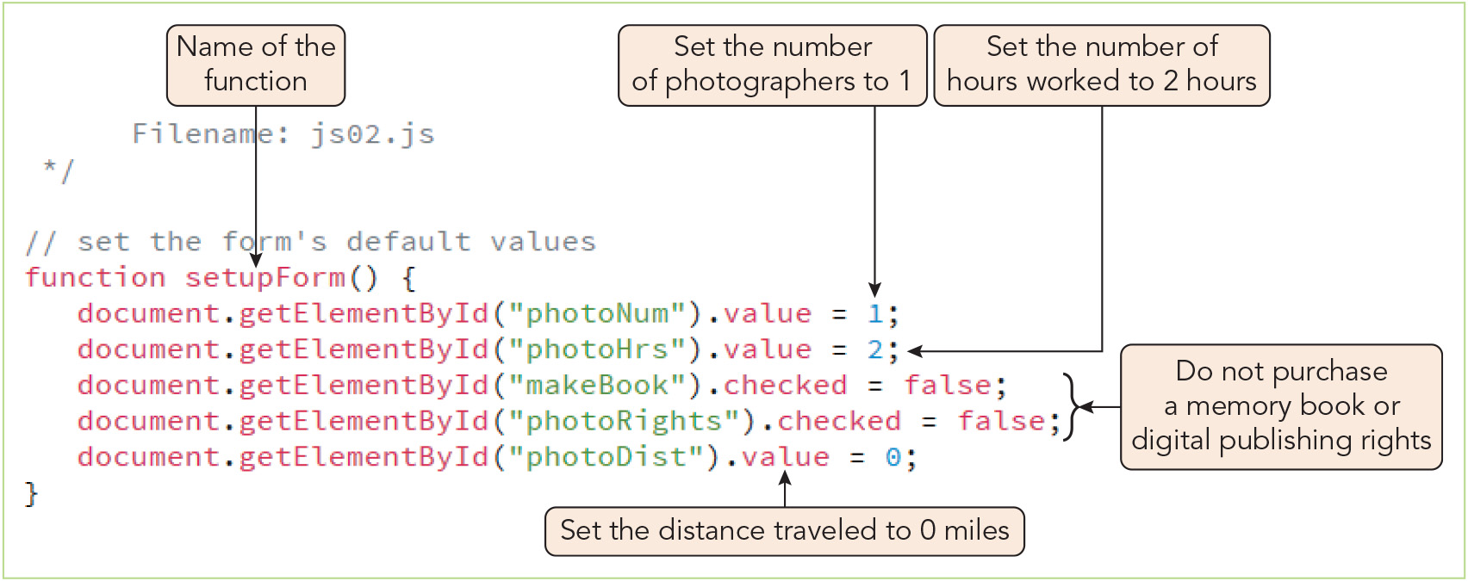
Working with Functions (3 of 4)
Figure 2-2 Creating the setupForm() function

Slide 7
Working with Functions (4 of 4)
Calling a function
JavaScript expression for calling a function: functionName(paramValues);
paramValues passed to a function are the arguments (actual parameters)
Returning a value from a function
Syntax for a function that returns a value: function functionName(parameters) { statements return value; }
return statement ends execution and returns a single value

Slide 8
Managing Events with Functions (1 of 3)
Using event handlers
Most direct method of associating a function with an event
Drawback: places JavaScript code in the HTML file
Syntax for creating an event handler as an attribute of the HTML element: <elem onevent = "function()">
Events as object properties
Places the event handler within the JavaScript code file
Can only specify function name, not parameter values
Only one function can handle an event at a time
Syntax for an event as an object property: object.onevent = function;

Slide 9
Managing Events with Functions (2 of 3)
Event listeners
An event listener listens for an event as it propagates through a web page, during either:
The capture phase (event moves down the object hierarchy) or
The bubbling phase (event moves back up the object hierarchy)
Can attach multiple functions to the same event
Syntax for method that attaches an event listener to an object: object.addEventListener("event", function, capture)
Events and anonymous functions
Include entire structure of anonymous function in place of function name in an event handler or event listener
Can pass in parameter values with this approach

Slide 10
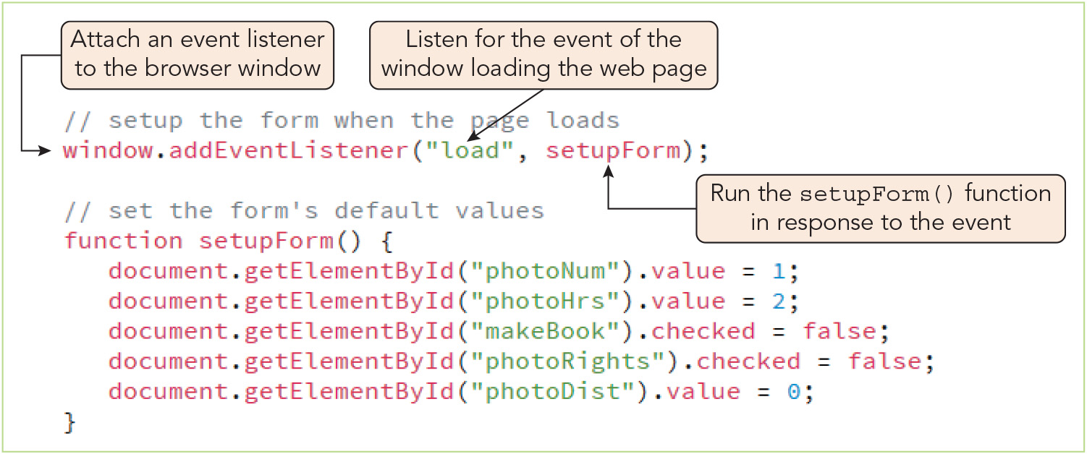
Managing Events with Functions (3 of 3)
Figure 2-3 Creating an event listener

Slide 11
Using Built-in JavaScript Functions (1 of 2)
Function | Description
decodeURI (string) | Decodes text strings encoded with encodeURI()
decodeURIComponent (string) | Decodes text strings encoded with encodeURIComponent()
encodeURI (string) | Encodes a text string so it becomes a valid URI
encodeURIComponent (string) | Encodes a text string so it becomes a valid URI component
eval (string) | Evaluates expressions contained within strings
isFinite (number) | Determines whether a number is finite
isNaN (number) | Determines whether a value is the special value NaN (Not a Number)
parseFloat (string) | Converts string literals to floating-point numbers
parseInt (string) | Converts string literals to integers

Slide 12
Using Built-in JavaScript Functions (2 of 2)
Example of using built-in function to verify the socialSecurityNumber variable is not a number: let socialSecurityNumber = "123-45-6789"; let checkVar = isNaN(socialSecurityNumber); document.write(checkVar);

Slide 13
Understanding Variable Scope (1 of 3)
Scope: where a variable or function can be called within the program
Variable/function is only recognized within scope
Referencing elsewhere results in an error
let and var declaration scopes
Variables declared with let are block scoped: scope is limited to the command block
Variables declared with var are function scoped: scope is limited to the function
Local and global scope
Variables/functions with local scope (e.g., local variables) are accessible within the command block or function where they are defined
Includes block scope and function scope
Those with global scope (e.g., global variables) are defined outside a block/function and thus accessible throughout the program

Slide 14
Understanding Variable Scope (2 of 3)
Local and global scope (continued)
Can create local and global variables with the same name but different values
Local variable takes precedence when in scope
Assigning a value to the local variable does not affect the global variable’s value outside the local variable’s scope
Global variables most useful for small applications and variables used as constants
Local variables preferable for values used within and changed by functions

Slide 15
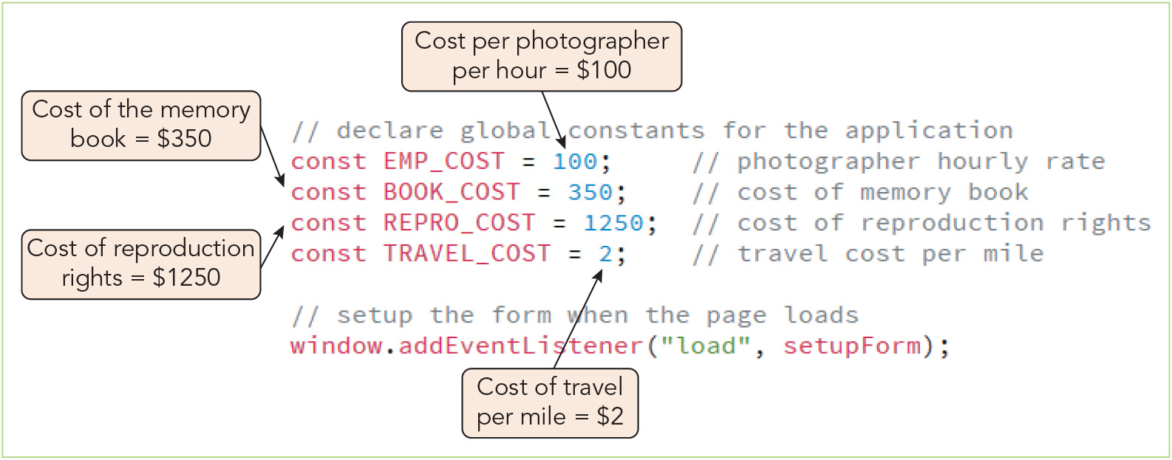
Understanding Variable Scope (3 of 3)
Figure 2-5 Declaring constant variables

Slide 16
Activity 2.1: Knowledge Check
Describe the syntax for creating and then calling a function.
What type(s) of scope do the variables in this code sample have? let quantityPerBox = 12; function describeCandy(productName, numberOfBoxes) { var numberCandies = quantityPerBox * numberOfBoxes; document.write("You would like " + numberCandies + " of our " + productName + " candies!"); }
Notes:
Instructions:
Use the Knowledge Check questions to periodically pose a question to students during class to gauge how well they can recall the material that was presented.

Slide 17
Activity 2.1: Knowledge Check Answers (1 of 2)
Describe the syntax for creating and then calling a function. Syntax for a named function: function functionName(parameters) { statements } Syntax for an anonymous function: function (parameters) { statements } Syntax for calling a function: functionName(paramValues);
Notes:
Instructions:
Use the Knowledge Check questions to periodically pose a question to students during class to gauge how well they can recall the material that was presented.

Slide 18
Activity 2.1: Knowledge Check Answers (2 of 2)
What type(s) of scope do the variables in this code sample have? let quantityPerBox = 12; function describeCandy(productName, numberOfBoxes) { var numberCandies = quantityPerBox * numberOfBoxes; document.write("You would like " + numberCandies + " of our " + productName + " candies!"); } quantityPerBox has global scope, unless this code appears within a command block in the larger program, in which case it would have block scope, a type of local scope. numberCandies has function scope, a type of local scope. You can’t determine the scope of productName or numberOfBoxes from this sample since they aren’t declared here.
Notes:
Instructions:
Use the Knowledge Check questions to periodically pose a question to students during class to gauge how well they can recall the material that was presented.

Slide 19
Working with Data Types (1 of 6)
Data type: the specific category of information that a variable contains
Primitive types: data types that can be assigned only a single value
Data Type | Description
number | A positive or negative number with or without decimal places, or a number written using exponential notation
Boolean | A logical value of true or false
string | Text such as “Hello World!”
undefined | An unassigned, undeclared, or nonexistent value
null | An empty value

Slide 20
Working with Data Types (2 of 6)
Strongly typed (statically typed) programming languages require that you declare the type of data that a variable contains and do not allow you to alter that type
Loosely typed (duck typed, dynamically typed) programming languages do not require you to declare the data type and allow data types to be change
JavaScript is loosely typed
Data types cannot be declared when variables are created
JavaScript interpreter determines and assigns or reassigns the variable’s data type based on the type of data stored
diffTypes = "Hello World!"; // String diffTypes = 8; // Integer number diffTypes = 5.367; // Floating-point number diffTypes = true; // Boolean diffTypes = null; // Null

Slide 21
Working with Data Types (3 of 6)
Working with numeric values
Integer: positive or negative number without decimal places
Floating point number: positive or negative numbers containing decimal places
Can be written in exponential notation (scientific notation): 2.0e6 = 2 ✖️ 10⁶ = 2,000,000
Use integers to calculate monetary values
Calculations on integer values, but not on floating point numbers, are the same in binary and decimal
Working with Boolean values
Boolean value: a logical value of true or false
Most often used for controlling program flow or for data comparisons

Slide 22
Working with Data Types (4 of 6)
Working with strings
Text string: zero or more characters surrounded by double or single quotation marks
Empty string: zero-length string value
Can use quotation marks within strings: document.write("Welcome to 'Fan Trick Photography’”); document.write('Welcome to "Fan Trick Photography”’);
To split a text string onto a new line without causing an error:
Use two or more strings concatenated by the addition operator (+)
For some browsers, end a line with the \ character to indicate the string continues
Create a template literal by enclosing the string in backtick characters (`)

Slide 23
Working with Data Types (5 of 6)
Escape characters and sequences
An escape character is placed before characters within strings to indicate that they are to be treated as regular keyboard characters, not as syntax
JavaScript’s escape character is the backslash (\)
Escape sequence: combination of an escape character with a specific character, usually to carry out a special function

Slide 24
Working with Data Types (6 of 6)
Escape Sequence | Character
\\ | Backslash
\b | Backspace
\r | Carriage return
\" | Double quotation mark
\f | Form feed
\t | Horizontal tab
\n | Newline
\0 | Null character
\' | Single quotation mark (apostrophe)
\v | Vertical tab
\xXX | Latin-1 character specified by the XX characters, which represent two hexadecimal digits
\uXXXX | Unicode character specified by the XXXX characters, which represent four hexadecimal digits

Slide 25
Using Operators to Build Expressions (1 of 9)
Two types of JavaScript operators: binary and unary
Binary operator: requires an operand before and after the operator
Arithmetic operators: operators used to perform mathematical operations
Operator | Description | Expression | Returns
+ | Combines or adds two items | 12 + 3 | 15
– | Subtracts one item from another | 12 – 3 | 9
* | Multiplies two items | 12*3 | 36
/ | Divides one item by another | 12/3 | 4
% | Returns the remainder (modulus) after dividing one integer by another integer | 18%5 | 3
** | Raising a value to a power | 3**2 | 9

Slide 26
Using Operators to Build Expressions (2 of 9)
Arithmetic operators (continued)
Unary operator: requires just a single operand either before or after the operator
Operator | Description | Expression | Returns
++ | Increases a value by 1 | 12++ | 13
– – | Decreases a value by 1 | 12– – | 11
– | Changes the sign of a value | –12 | –12

Slide 27
Using Operators to Build Expressions (3 of 9)
Arithmetic operators (continued)
Two types of unary operators:
Prefix operators, which are placed before the variable
Postfix operators, which are placed after the variable
Prefix operator is applied before assignment operator: let x = 5; let y = ++x // x = 6 and y = 6
Postfix operator is applied after assignment operator: let x = 5; let y = x++ // x = 6 and y = 5

Slide 28
Using Operators to Build Expressions (4 of 9)
Assignment operators
An assignment operator (e.g., =) is used for assigning a value to a variable
Compound assignment operators both assign a value and perform a calculation
Interpreter will attempt to convert a nonnumeric to a numeric operand
Operator | Example | Equivalent to
= | x = y | x = y
+= | x += y | x = x + y
–= | x –= y | x = x – y
*= | x *= y | x = x * y
/= | x /= y | x = x/y
%= | x %= y | x = x % y
**= | x **= y | x = x**y

Slide 29
Using Operators to Build Expressions (5 of 9)
Comparison operators (relational operators): used to compare two operands
Two nonnumerical operands are compared in lexicographical order
String plus number: interpreter converts string to number or returns false
Operator | Example | Description
== | x == y | Tests whether x is equal in value to y
=== | x === y | Tests whether x is equal in value to y and has the same data type
!= | x != y | Tests whether x is not equal to y or has a different data type
!== | x !== y | Tests whether x is not equal to y and/or doesn’t have the same data type
> | x > y | Tests whether x is greater than y
>= | x >= y | Tests whether x is greater than or equal to y
< | x < y | Tests whether x is less than y
<= | x <= y | Tests whether x is less than or equal to y

Slide 30
Using Operators to Build Expressions (6 of 9)
Conditional operators (ternary operators) return one of two possible values given the Boolean value of comparison
Syntax: condition ? trueValue : falseValue;
Condition can be any expression that equals true or false, including a Boolean variable
Can return an expression instead of a value
Understanding falsy and truthy values
Falsy values, equivalent to false: "" (empty string), -0, 0, NaN, null, undefined
Everything else is a truthy value, equivalent to true
Can often use truthy and falsy values to make comparison operations more compact by omitting the comparison operator

Slide 31
Using Operators to Build Expressions (7 of 9)
Logical operators
Used to combine expressions that will result in a Boolean value of true or false
Used for negating (swapping) a Boolean value
Multiple conditions can be grouped within parentheses to create more complicated statements
Operator | Definition | Example | Description
&& | and | (x === 5) && (y === 8) | Tests whether x is equal to 5 and y is equal to 8
|| | or | (x === 5) || (y === 8) | Test whether x is equal to 5 or y is equal to 8
! | not | ! (x < 5) | Test whether x is not less than 5

Slide 32
Using Operators to Build Expressions (8 of 9)
Name | Special Operator | Description
Property access | . | Appends an object, method, or property to another object
Array index | [] | Accesses an element of an array
Function call | () | Calls up functions or changes the order in which individual operations in an expression are evaluated
Comma | , | Separates multiple expressions in the same statement
Conditional expression | ?: | Executes one of two expressions based on the results of a conditional expression
Delete | delete | Deletes array elements, variables created without the var keyword, and properties of custom objects

Slide 33
Using Operators to Build Expressions (9 of 9)
Name | Special Operator | Description
Property exists | in | Returns a value of true if a specified property is contained within an object
Object type | instanceof | Returns true if an object is of a specified object type
New object | new | Creates a new instance of a user-defined object type or a predefined JavaScript object type
Data type | typeof | Determines the data type of a variable
Void | void | Evaluates an expression without returning a result

Slide 34
Activity 2.2: Think, Pair, and Share
Form pairs/groups of two to four class members.
Your group will be working with a floating point number variable called totalDue, which represents money owed by a customer. Work together to write a function to perform each of the following tasks:
Add a $5 handling charge to totalDue.
Add both a $5 handling charge and a 15% heavy item charge. The heavy item charge should be calculated before the handling charge is added to totalDue.
Now write code that calls the first function if the totalWeight variable’s value is less than 20 or the second function if totalWeight is greater than or equal to 20.
Notes:
Instructions:
Use the Think, Pair, Share activity to encourage students to solve problems collaboratively and to apply the real-world skill of evaluating, modifying, and debugging code created by another programmer.

Slide 35
Understanding Operator Precedence (1 of 3)
Operator precedence determines the order in which operations in an expression are evaluated
Associativity determines precedence for operators with equal intrinsic precedence
Examples:
5 + 2 * 8 evaluates to 21
30 / 5 * 2 evaluates to 12
let x = 3; let y = 2; x = y *= ++x; // Value of both x and y is 8
(5 + 2) * 8 evaluates to 56

Slide 36
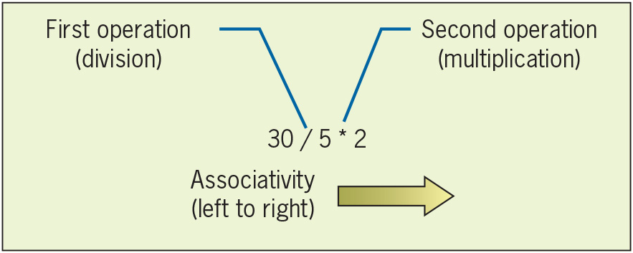
Understanding Operator Precedence (2 of 3)
Figure 2-16 Left-to-right associativity

Slide 37
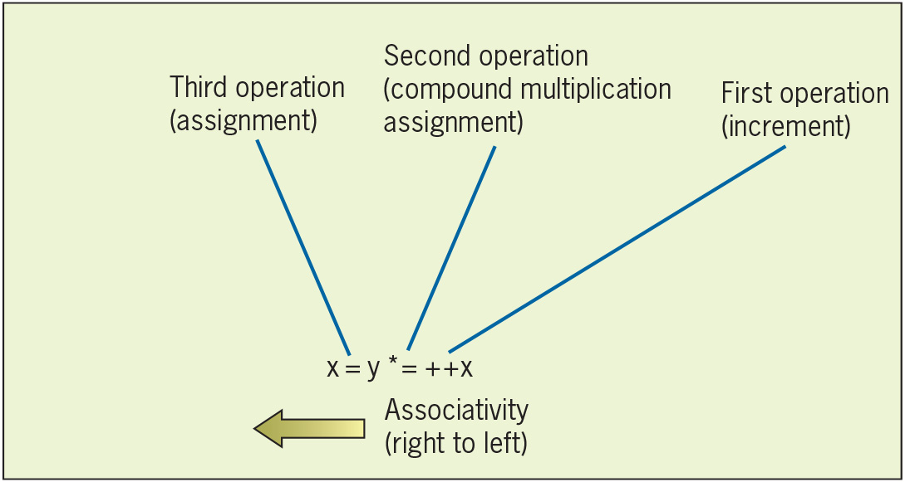
Understanding Operator Precedence (3 of 3)
Figure 2-17 Right-to-left associativity

Slide 38
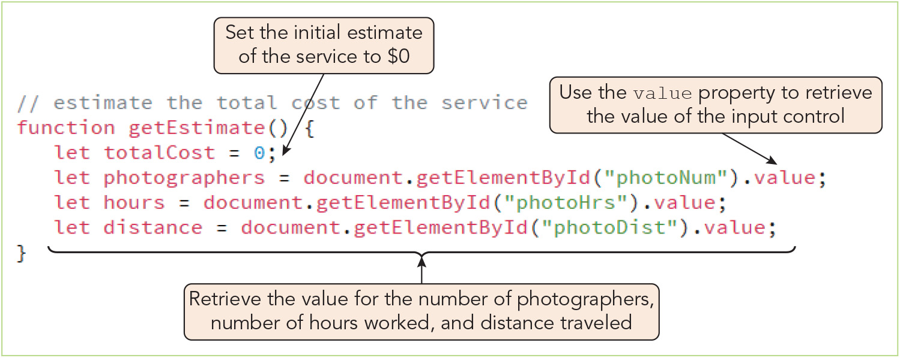
Using Expressions with Web Form Controls (1 of 7)
Figure 2-18 Retrieving input control values

Slide 39
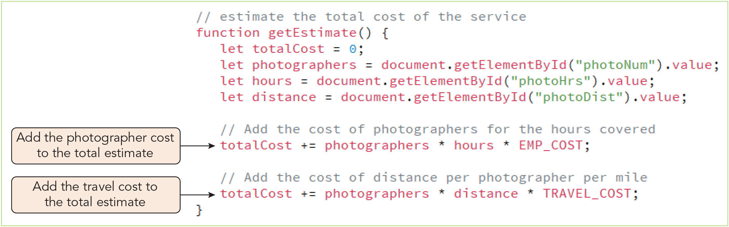
Using Expressions with Web Form Controls (2 of 7)
Figure 2-19 Adding to the total cost estimate

Slide 40
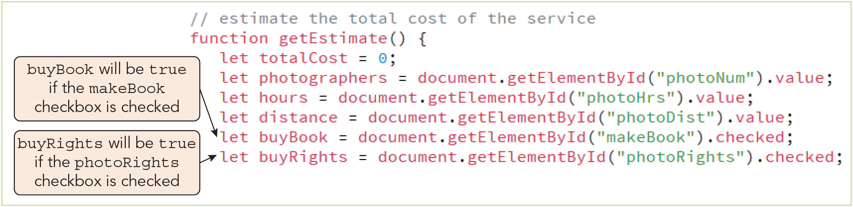
Using Expressions with Web Form Controls (3 of 7)
Figure 2-20 Retrieving the checked status of web form checkboxes

Slide 41
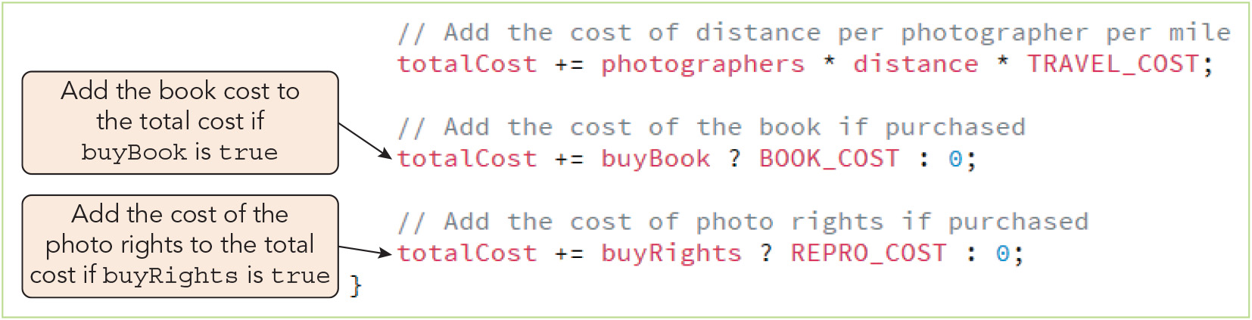
Using Expressions with Web Form Controls (4 of 7)
Figure 2-21 Adding the cost of the memory book and the photo rights

Slide 42
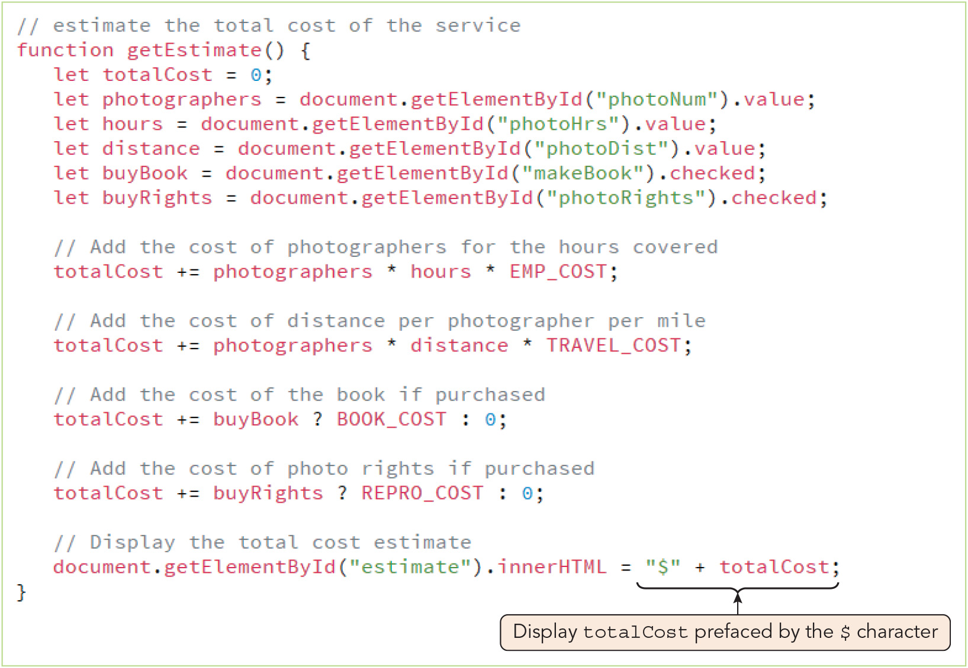
Using Expressions with Web Form Controls (5 of 7)
Figure 2-22 Displaying the total cost estimate in the web page

Slide 43
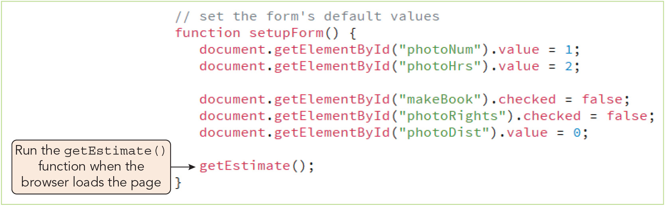
Using Expressions with Web Form Controls (6 of 7)
Figure 2-23 Calling the getEstimate() function when the page loads

Slide 44
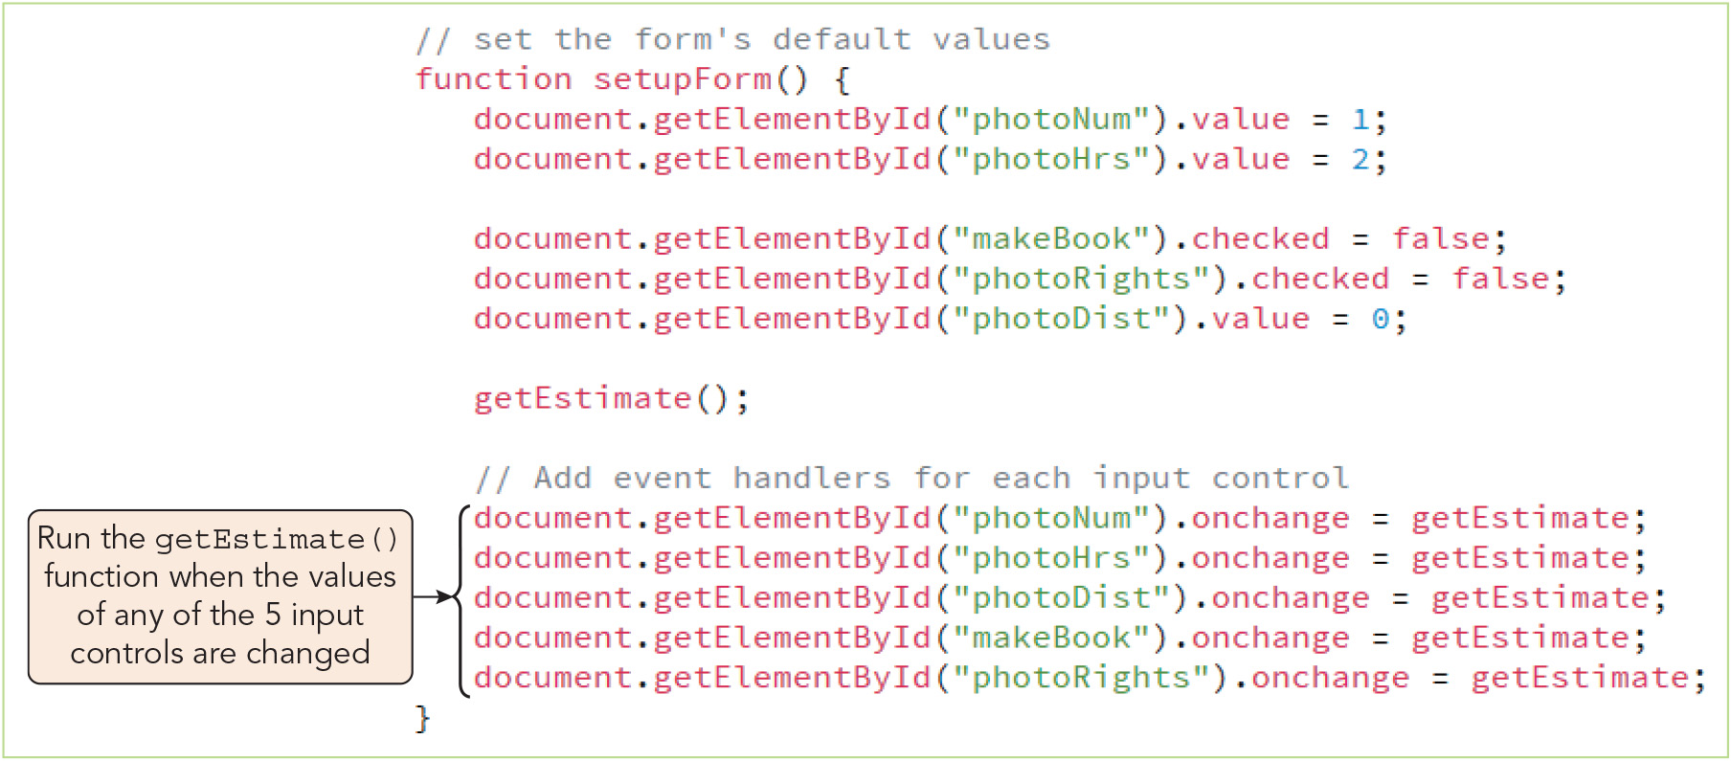
Using Expressions with Web Form Controls (7 of 7)
Figure 2-25 Adding event handlers for each input control

Slide 45
Locating Errors with the Browser Console (1 of 3)
Accessing the browser console (console) displays error messages from the browser
Locating an error in your program
Browser console reports the line where detected each error is located
Also reports lines that failed to run
Be sure to make permanent corrections to code within your code editor

Slide 46
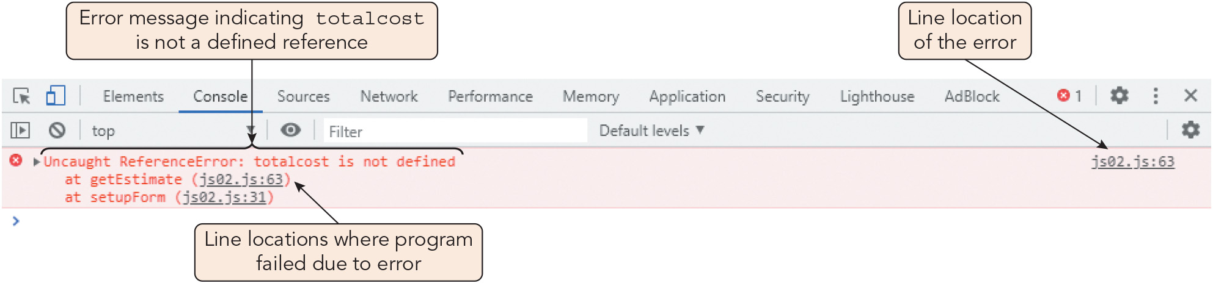
Locating Errors with the Browser Console (2 of 3)
Figure 2-28 Browser console message in the Google Chrome browser

Slide 47
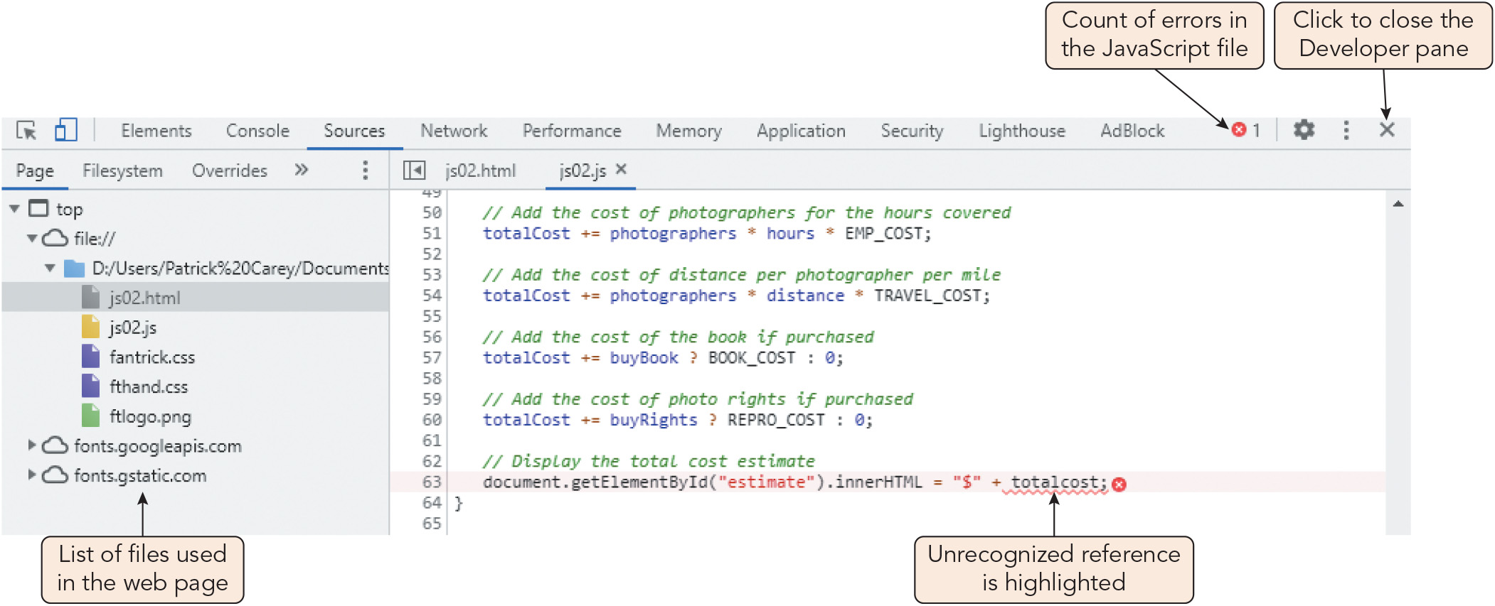
Locating Errors with the Browser Console (3 of 3)
Figure 2-29 Console showing the location of the error

Slide 48
Activity 2.3: Discussion Questions
What are the similarities between a function and a procedure?
Why does there need to be a set order of precedence for the JavaScript operators?
Notes:
Instructions:
Use the Discussion activity to encourage group conversation about a related topic of interest.

Slide 49
Self-Assessment
What role will functions play in the JavaScript programs that you write?
How do you plan to use your knowledge of variable and function scope to avoid errors and keep your code easy to understand and maintain?
Name some ways you can use JavaScript operators that were new to you when you read this chapter or that you find especially useful.
Notes:
Instructions:
Use the Self-Assessment question to encourage students to evaluate their progress or goals in the course, as well as determine how they might apply their learning or grow as an individual.

Slide 50
Summary
Now that the lesson has ended, you should have learned to:
Write and call functions to perform actions and calculate values.
Associate functions with events using event handlers and event listeners.
Use built-in JavaScript functions.
Understand the scope of variables and functions.
Understand the data types supported by JavaScript and write expressions with numeric values, text strings, and Boolean values.
Create expressions using arithmetic, assignment, comparison, logical, string, and special operators.
Understand order precedence and associativity of operations.
Work with events and values associated with form controls.
Access your browser’s debugging console.
Notes:
Instructions: Reiterate the learning objectives for the lesson. Students should use this information to guide their studies and reinforcement of new concepts.

